Slide 1
Domain-Driven Design An introductory overview
Freek Paans, May 2015

Slide 2
Who this talk is for
People interested in DDD
People wanting a starting point in DDD
People that want a refresher on some basic points of DDD
Notes:
It’s not for people that are looking for practical expereinces

Slide 3
Agenda
Who this talk is for
Why am I talking about this?
Domain modeling
Example
Domain model revisited
Closing

Slide 4
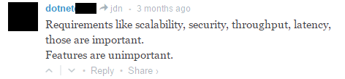
Why am I talking about this?
Programming business software is about solving problems of the business, not about solving technical problems
Notes:
Too many people still think the above
Connection business <-> softtware
Focus on business

Slide 5
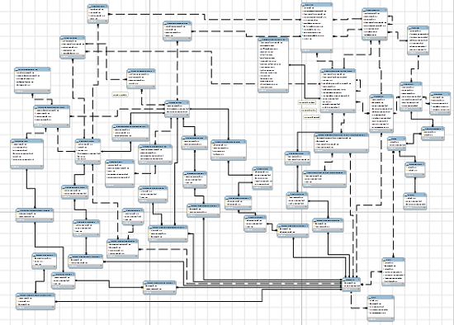
Also
How do we manage this complexity?
Notes:
Software tends to get very complex, technically
Unmaintainable
Hard to add stuff
Actually, domains are complex

Slide 6
Why am I talking about this?
1. We need to cultivate the idea that the most interesting part of software is in the domain
2. We need practical tools, guidelines, principles, practices and strategies to develop software for complex domains

Slide 7
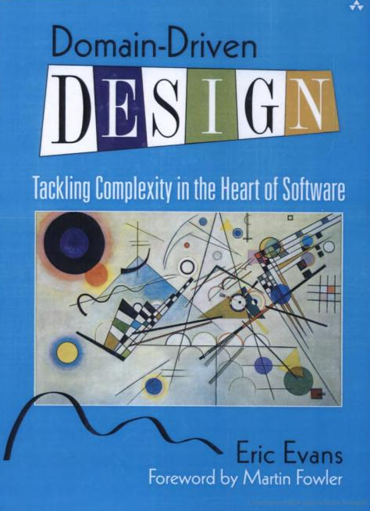
Enter DDD…
“The premise of this book is twofold:
For most software projects, the primary focus should be on the domain and domain logic
Complex domain designs should be based on a model”
DDD is both a mindset and provides practical guidance to build “complex” applications
Notes:
DDD focuses on domain/problem space, puts this in the mind of the developer
DDD provides methods to effectively build software that

Slide 8
Basic DDD strategy
Talk to the domain expert a bit
Draw up candidate domain model
Verify model with the expert (goto 1)
Verify model with code
Goto 1
DDD is inherently iterative

Slide 9
DDD in this talk: Domain modeling
Some basic terms
The domain model
An example
The domain model revisited
Notes:
As said before, DDD is as much a mindset as tools. The domain is where the fun is. The primary focus should be the domain
The book says it’s not a methodology, but requires iterative development.
Design method to build software for complex domains
In this talk I’ll go through some of the IMO most important issue
I’m gonna mention specific tools/building blocks throughout
Not gonna give an entire overview of the entirety of DDD, just the parts that I find most relevant.

Slide 10

What is complexity?
Is the solution more complex than the domain?
Is the domain complexity present in the solution?
Notes:
First of all what does complexity mean
2 kinds of complexity -> solution space, domain complexity
We’re terrible at capturing the domain complexity, but tend to introduce a lot of technical complexity.
A lot of complexity is introduced because we don’t understand the domain.
We assume constraints that aren’t -> atomical consistency, normalization, etc
Complexity: lots of moving parts

Slide 11
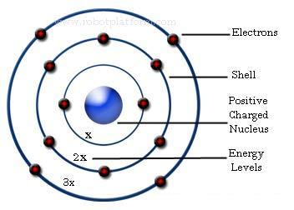
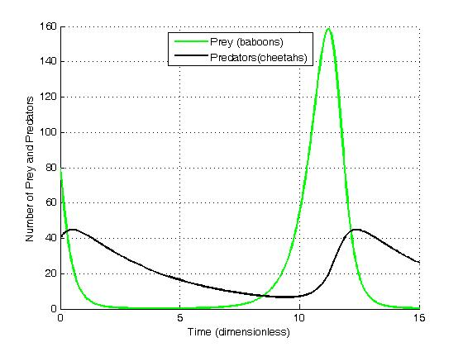
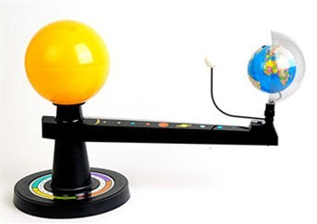
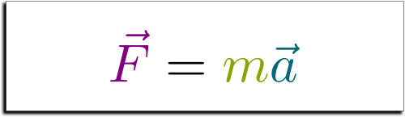
What is a model?
We create models to be able to reason about the behavior of a specific phenomena
Notes:
A model is not the artifact
Some models describe things that others leave out
Models abstract the things that are necessary to describe

Slide 12
The domain model
We create a model of the domain to be able to reason about the complexity in the domain, allowing us to solve the problems at hand
“(Complex domain) designs should be based on a model”
Notes:
Parentheses added -> designs for complex domains should be based on a model
A model is a rigorously organized and selective abstraction of the knowledge of a domain expert
A model allows us to reason about real-world phenomena
Shouldn’t use for non-complex domains
A domain model captures the parts of the real world that we need to solve the business problems
I’m introducing building blocks as we go

Slide 13
A good domain model…
Captures knowledge from the domain expert
Has its own ubiquitous language
Is owned and understandable by team, including customer
Can be implemented in code
Uses agreed upon building blocks
Is valid within a bounded context
Is built iteratively
Notes:
Make implicit knowledge explicit
Customer and developers work together to create the model
Terms have specific meaning
Model only valuable when expressed in code Not a throw away thing

Slide 14
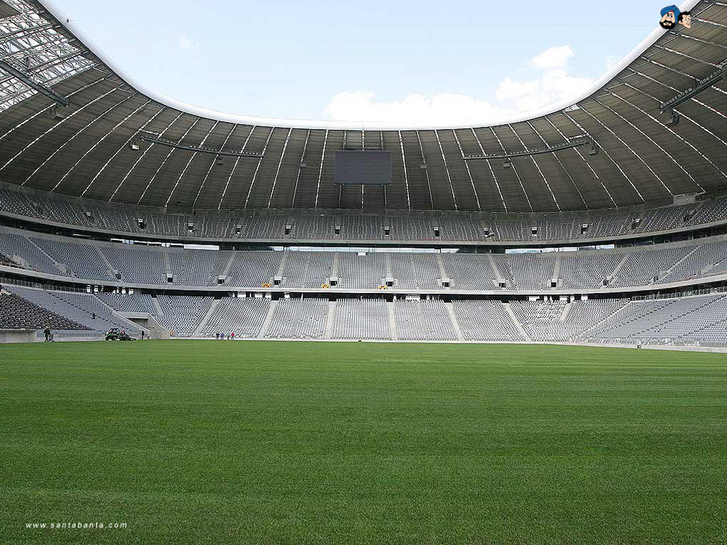
An example
Develop an online system for booking football game tickets
Requirement:
User needs to be able to book seats in the stadium for a given game
Notes:
Warning about toy examples

Slide 15
Talking to the domain expert…
Prices vary only based on the row in which you are
Online sales start 2 weeks in advance, end 24 hours before the game
Seats are assigned to the person that placed the order

Slide 16
A first candidate…
Stadium
Game
BookSeat(Game, Seats, Payment, Name)
IsBookable()
Date
1
*
Row
Seat
BookSeat(Game, Seat, Payment, Name)
Price per seat
OccupyBy(Game,Name)
Person name
1
*
Notes:
First thing to note-> a representation of the domain model
This representation is sketched together with domain expert
We explain the idea of classes and such to domain expert

Slide 17
Verify with expert
Most knowledge (for current problem) seems in there
After explaining, class concept made sense
Language is mostly in there, missing Online sales and ticket, but doesn’t seem to be a problem for now
Notes:
Model is ready for implementation

Slide 18
Verify with code
The final test of our model is whether we can actually implement it in code
The code should be strongly bound to the model:
Use the same (ubiquitous) language
Reflect nouns as language constructs for decomposition (classes)
Reflect verbs as actions (methods)
When a customer calls, you should be able to Ctrl+F what she’s talking about
Notes:
It’s important to bind the model and implementation
Fairly trivial to implement the model, since we choose uml class diagram
If model and implementation diverge, the model becomes useless

Slide 19
The classes
Stadium
Game
BookSeat(Game, Seats, Payment, Name)
IsBookable()
Date
1
*
Row
Seat
BookSeat(Game, Seat, Payment, Name)
Price per seat
OccupyBy(Game,Name)
Person name
1
*
UML is fine for sketching an initial representation together with the domain expert

Slide 20
How to hook it all up?
It’s important not to clutter the domain model with other concerns, so we need to isolate the domain
This is the boring, but also hard, stuff..

Slide 21
Layered architecture
UI
(REST, MVC, etc)
Infra
(Repositories)
Application
AKA service, facade
Domain
Depends on
Notes:
Just one way of doing this

Slide 22
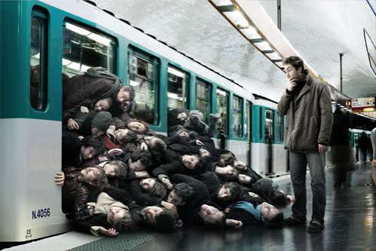
Problem!
What about concurrency?

Slide 23
Consistency
We can’t have multiple people booking the same seat (can we?)
What if prices change?
What if the game date changes?
Can we lock the entire stadium for each order?
Notes:
The current model doesn’t reflect consistency at all

Slide 24
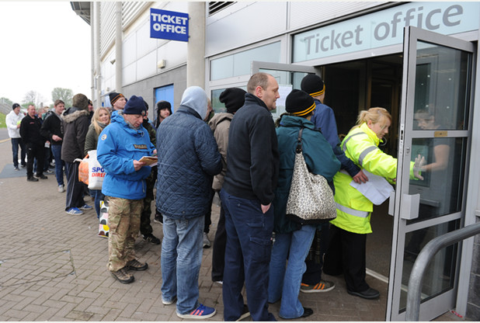
Consult with domain expert
95% of the orders are for 2 or more tickets
Popular games fill up in 15 minutes (50k seats)
Prices never change
When a game is postponed, everybody is refunded and need to rebook

Slide 25
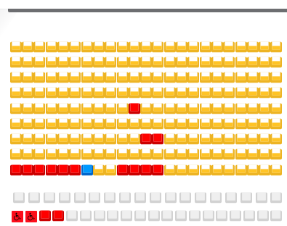
Rethinking the model
On peak moments people booking the same seats will occur too often, resulting in a bad user experience
We can’t lock the entire stadium for an order (even optimistically)
Solution:
book for row only
lock on row (optimistically)

Slide 26
Revised model
Row
Game
BookSeats(Game, Payment, SeatCount, Name)
Price per seat
Seats Available
Seats per name
IsBookable()
Date
Aggregate (consistency boundary)
Aggregates are building blocks to incorporate concurrency and consistency into the domain model
Notes:
We dropped the idea of seats and stadium in this model
Other building blocks: entities, values, services
Things within an aggregate are atomically consistent, outside not so

Slide 27
Implementation concerns feed back into the model(!)
Concurrency/consistency
Programming language
Persistence
Other tooling
Etc.
(even though consistency is not really an implementation concern if you think about it)
Notes:
Programming language constraints

Slide 28
Domain model revisited
Captures knowledge from the domain expert
Has its own ubiquitous language
Is owned and understandable by team, including customer
Can be implemented in code
Uses agreed upon building blocks
Is valid within a bounded context
Is built iteratively

Slide 29
Wrapping up

Slide 30
DDD solves 2 problems
Developer focus on technology
Harnessing complexity

Slide 31
This is done by
Cultivating that the true challenges lie in the domain (socially)
Closely collaborating with the customer to
Build and implement a model of the domain
Create a shared language

Slide 32
In closing

Slide 33
Not only for transaction processing
Complex (read) calculations
Simulations
Compilers
…

Slide 34
What’s more
DDD Building blocks
Strategic design: how to scale DDD?
CQRS
Event Sourcing
SOA

Slide 35
Thank you
Q/A?
Read the book (studygroup?)

